Slide 1

K.S.INSTITUTE OF TECHNOLOGY
DEPARTMENT OF COMPUTER SCIENCE ENGINEERING
(2021-22)
PROJECT REVIEW -1(18csp83)
PROJECT TITLE :
“DATASET SHIFT QUANTIFICATION FOR CREDIT CARD FRAUD DETECTION USING MACHINE LEARNING”
Batch no : 2021_CSE_14
BHAGYASHREE V- 1KS18CS128
BI BI AYESHA- 1KS18CS129
LIKITHA S- 1KS18CS130
SHALINI KP- 1KS18CS131
Under the Guidance of :
MR. ROOPESH KUMAR BN
Assistant professor
Dept of CSE,KSIT

Slide 2
CONTENTS
Introduction
Comparison with similar work
Problem Statement and Objectives
Methodology Proposed/ Design
Technologies / Tools Used
Implementation of Modules with codes
Snapshots
References

Slide 3
INTRODUCTION :
Today, credit cards are widely available all over the world, and businesses of all sizes are storing data with a high volume, variety, speed, and value.
Credit card fraud detection presents several difficulties. One of them is the fact that purchase behaviour may evolve over time.
This dataset shift or concept drift may cause issues since the fraud detection system may become in adapted: the decision function it learnt on the training set does not correspond to the distribution of the testing set.
Concept drift and dataset shift have already been described in the literature. Some works focused on characterizing the concept drift whereas others aimed to adapt to it.

Slide 4
COMPARISION WITH SIMILAR WORK
Methodology | Techniques | Outcome
Fraud detection in credit card data using unsupervised machine learning based scheme. | Supervised learning Hidden Markov model Markov-chain model | Fraud detection algorithms are implemented in Python, Performance analysis of various clustering algorithms on different metrics.
Credit card fraud detection using machine learning Alogorithms. | Random Forest Algorithm Adaboost Algorithm | Accuracy is same for both Random Forest and Adaboost Algorithm but Random forest algorithm works best to detect credit card frauds.
Credit card fraud detection techniques: Data and Technique Oriented Prespective | Computational intelligence A novel machine learning algorithm A fusion approach | This study deals with techniques that helps to find out the credit card frauds.
Credit card fraud detection using dataset shift quantification. | Covariate shift Quantification Dataset shift knowledge | This strategy allows us to build a distance matrix characterizing the covariate shift between the data.
Varying credit card fraud data. Reducing the complexity. Comparision of different machine learning algorithm. | Logistic regression SVM K-Neighbor classifier Naive Bayes | This generates more accurate results with credit card fraud detection,reduces fraud by detecting it at early stage.

Slide 5
PROBLEM STATEMENT AND OBJECTIVE
“To design and develop a secure and privacy protected application for credit card fraud detections using machine learning.”

Slide 6
PROBLEM STATEMENT AND
OBJECTIVE
Objective:
We develop a system to keep record of every fraudulent credit card transaction online.
To identify suspecious events and report to the relevant customer immediately.
A system to easily detect a stolen credit card.
To easily track & report fraudulent transactions to relevant customer.

Slide 7
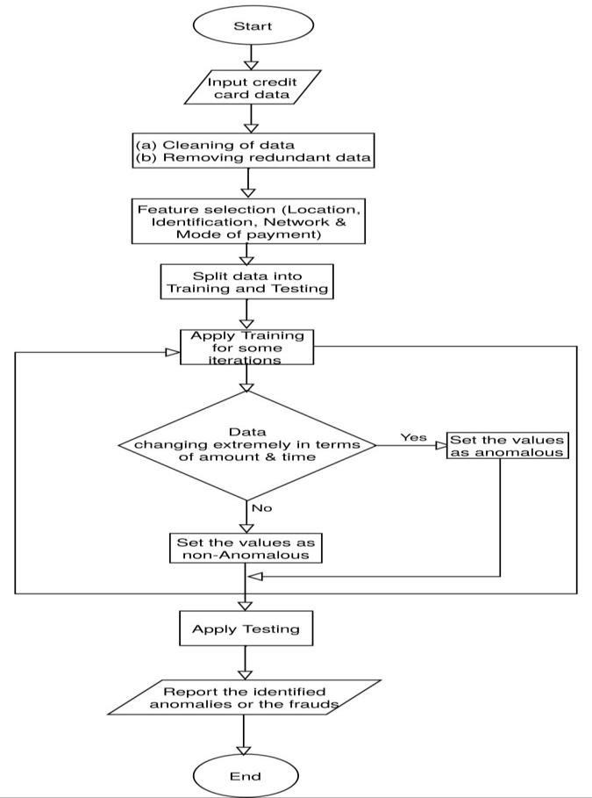
METHODOLOGY PROPOSED

Slide 8
METHODOLOGY PROPOSED
FLOW DIAGRAM:
Incoming set of Transactions and amount
Decision if the Transaction is Fraud
(Or)
Genuine
Credit Card Fraud Detection System using Algorithms & Techniques
No
Credit Card Transactions
Fraudulent Transaction
Send mail
YES
Genuine Transaction

Slide 9
TECHNOLOGY USED
Backend: Python
Frontend: HTML,CSS,Javascript

Slide 10
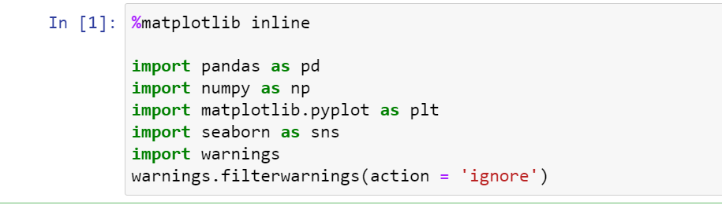
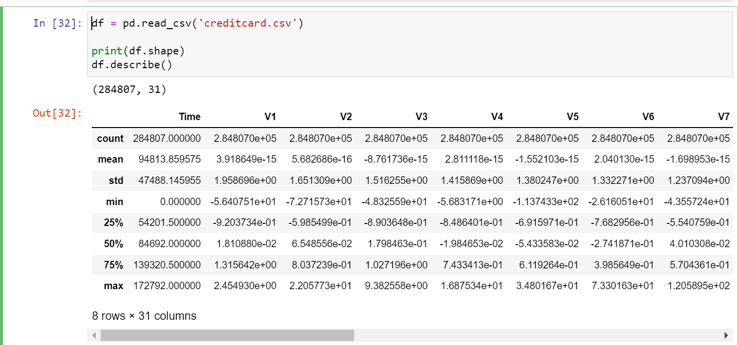
IMPLEMENTATION OF MODULES
LIBRARIES
matplotlib
Pandas
Numpy
seaborn
DATASET

Slide 11
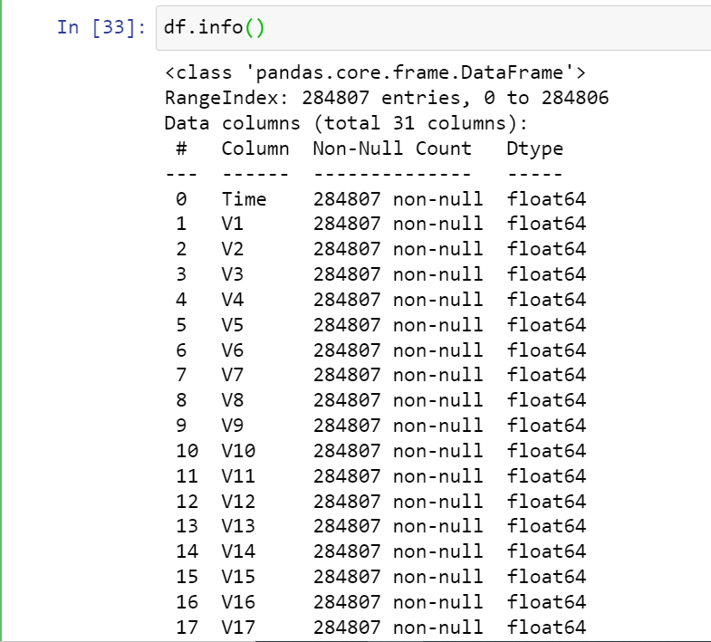
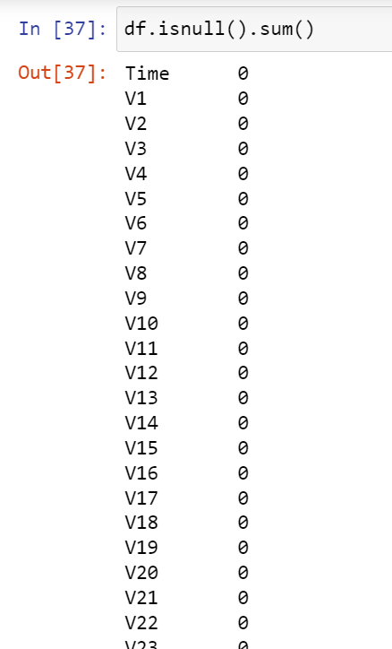
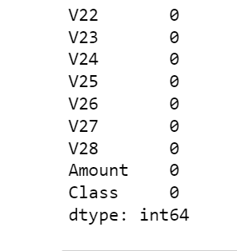
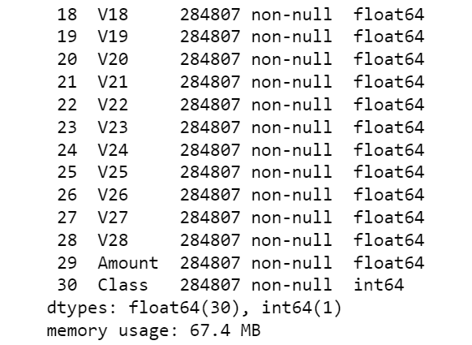
DATASET FEATURES
NULL VALUES
If no missing values found model will continue

Slide 12
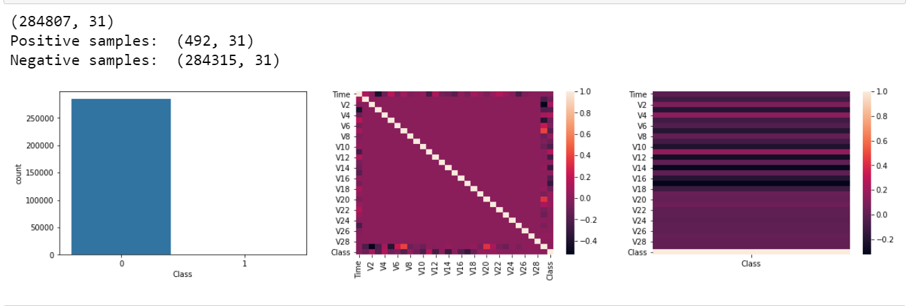
IMPLEMENTATION OF MODULES
GRAPHS OF DATASET SAMPLES:

Slide 13
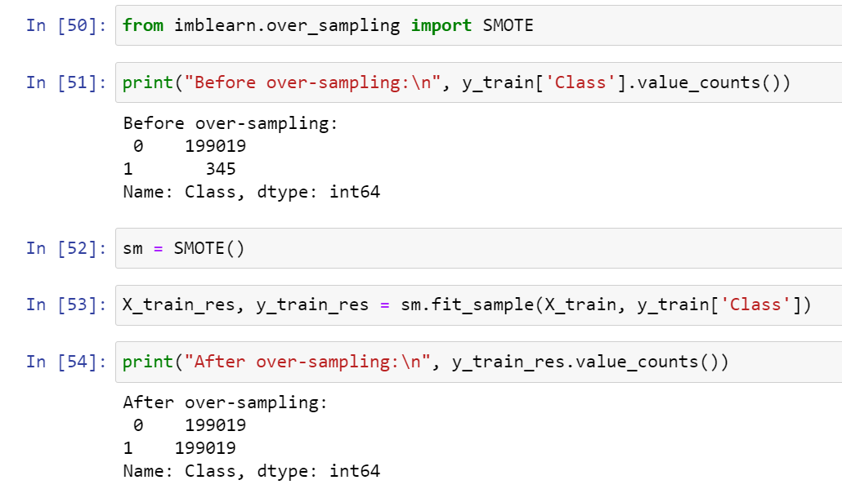
SNAPSHOTS
SAMPLING TECHNIQUES

Slide 14
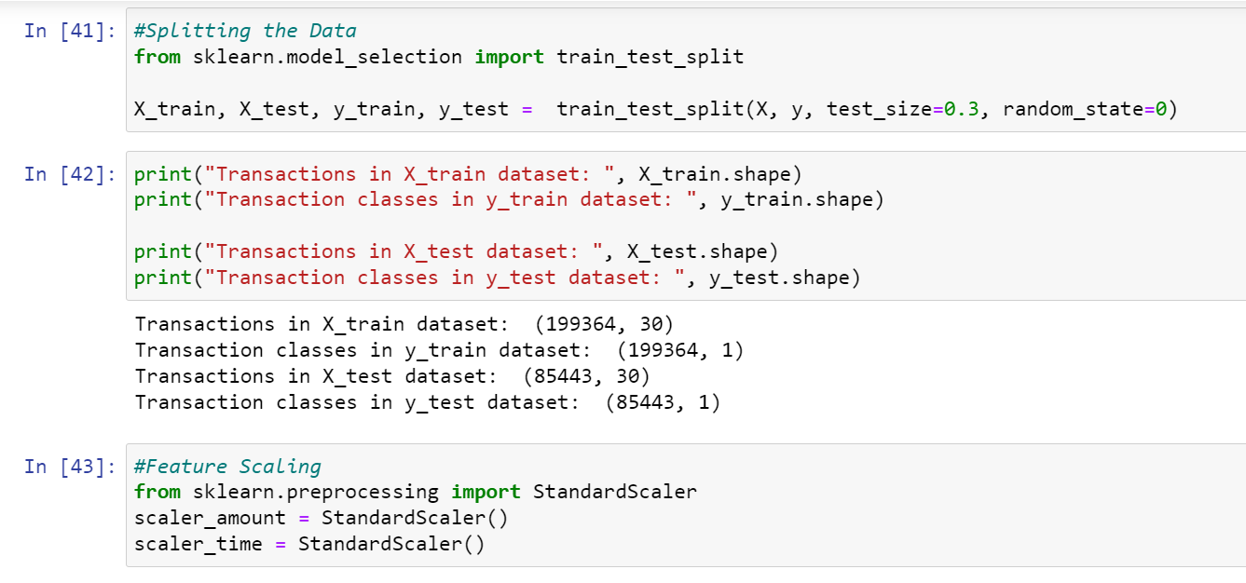
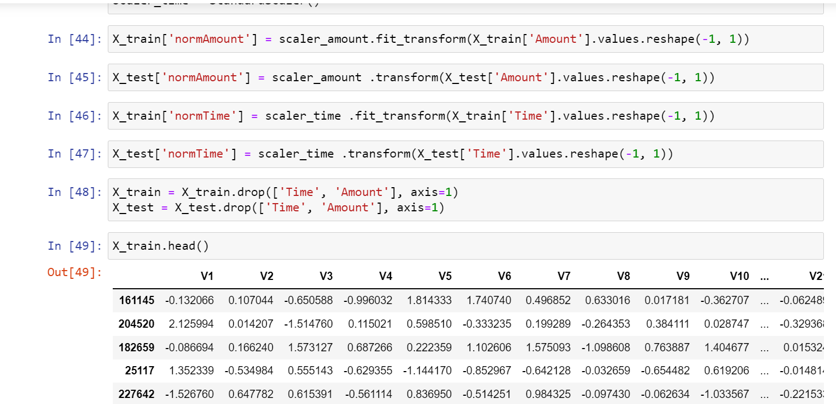
SNAPSHOTS
SPLITTING THE DATA
TRAINED DATA

Slide 15
REFERENCES
[1].Dataset collected from https://www.kaggle.com/datasets
[2].https://towardsdatascience.com/fraud-detection-unsupervised-anomalydetection-df43d81fce67
[3].Taha, S. J. Malebary, “Intelligent Approach to Credit Card Fraud Detect ion Using an OLightGBM”, IEEE Access (2020), pp.25579-25587
[4].S. N. Kalid, K. H NG, G. K Tong, K. C Khore., “A Mult iple Classifiers System for Anomaly Detect ion in Credit Card Data With Unbalanced and Overlapped Classes”, IEEE Access (2020), Vol. 8, pp. 28210-28221
[5].S. Makki, Z. A Assaghir, Y. Taher, R. Haque, M. S Hacid, H. Zeineddine, “An Experimental Study With Imbalanced Classificat ion Approaches for Credit Card Fraud Det ect ion”, Special Sect ion On Advanced Software And Data Engineering For Secure Societ ies, IEEE Access (2019), Vol 7, pp. 93010-93022
[6]https://www.avenga.com/magazine/anomaly-detection/
[7] Lucas Y., Portier P. E., Laporte L., Calabretto S., Caelen O., HeGuelton L., Granitzer M., (2019) Multiple perspectives HMM-based feature engineering for credit card fraud detection. 34th Symposium on Applied Computing

Slide 16
THANK YOU

